Slide 1


Introduction to
Robotic Process Automation
FLOWCHART GENERATOR BOT
220701046
Bhuvaneshwari M
Jinu Sophia, M.E.,(Ph.D)
B.E Computer Science and Engineering

Slide 2
Abstract
A Flowchart Generator Bot is an automated system that dynamically creates flowcharts based on user inputs, streamlining the process of visualizing workflows, algorithms, and processes.
It eliminates manual design efforts, ensuring accuracy and consistency across diagrams while supporting multiple formats like PlantUML or image exports.
The Flowchart Generator Bot is an automation tool built in UiPath to streamline the process of creating flowcharts.
By accepting a descriptive prompt, it automatically generates a flowchart that represents the given process or problem, and then emails the finished flowchart to users.

Slide 3
Need for the Proposed System
Modern workflows demand rapid and precise documentation of processes, which manual methods cannot fulfill efficiently.
A Flowchart Generator addresses this gap by automating diagram creation, saving time, and reducing errors.
It is especially beneficial in complex project environments requiring detailed, accurate visual representations.

Slide 4
Advantages of the Proposed System
Automation: Reduces manual effort in designing flowcharts.
Accuracy: Ensures consistency and error-free diagrams.
Versatility: Supports dynamic updates and multiple export formats.
Accessibility: Simple user interfaces suitable for professionals and students alike.

Slide 5
Literature Survey
Paper 1:
Automated Flowchart Systems in Modern Workplaces
Advantages: Time-saving, scalable, suitable for collaborative environments.
Disadvantages: Limited customization options in some tools.
Paper 2:
Integration of Dynamic Diagrams in Education
Advantages: Enhances learning through visual aids, reduces dependency on static teaching materials.
Disadvantages: Requires technical knowledge for initial setup.

Slide 6
Main Objective
The main objective of the Flowchart Generator Bot is to create an intuitive, efficient, and automated tool that dynamically generates flowcharts based on user input specifications.
This tool aims to simplify the visualization of workflows, algorithms, and business processes, ensuring accuracy and consistency in diagram creation.
Key objectives include:
Automation: Automate the flowchart generation process to save time and eliminate manual design efforts.
User-Friendly Interface: Provide an easy-to-use interface that allows users with minimal technical knowledge to create detailed and professional flowcharts.

Slide 7
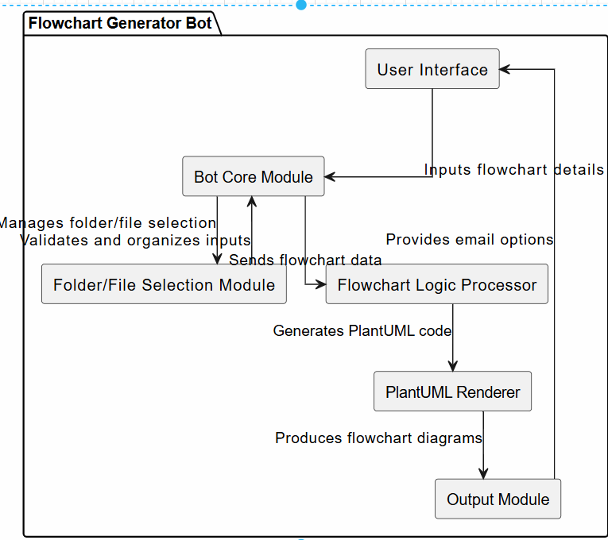
Architecture

Slide 8
System Requirements
Hardware:
  Minimum: 2 GHz CPU, 4GB RAM, 500MB free disk space.
  Recommended: 3 GHz CPU, 8GB RAM, SSD storage.
  UiPath Studio: Latest Version
Software:
  Windows/Linux/MacOS.
  Web browser: Chrome, Edge, FireFox.

Slide 9
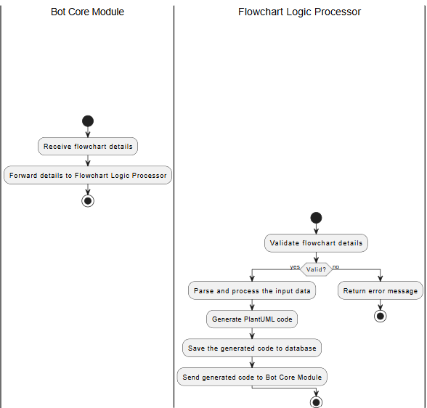
Functional Description
Flowchart Logic Processor: Parsing user-provided flowchart details. Generating PlantUML or other intermediate code.

Slide 10
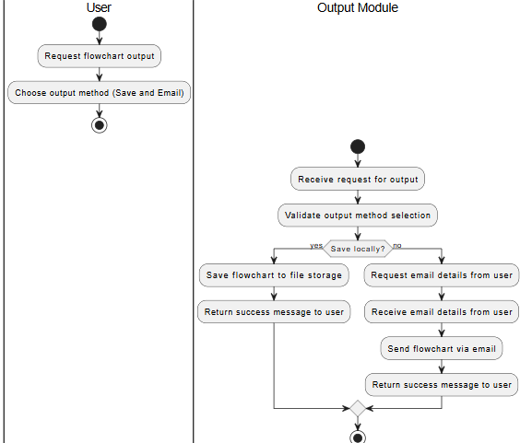
Functional Description
Output Module: The Output Module is responsible for producing the final flowchart in the desired format. It also provides additional functionalities such as saving the output to a local system or sending it via email.

Slide 11
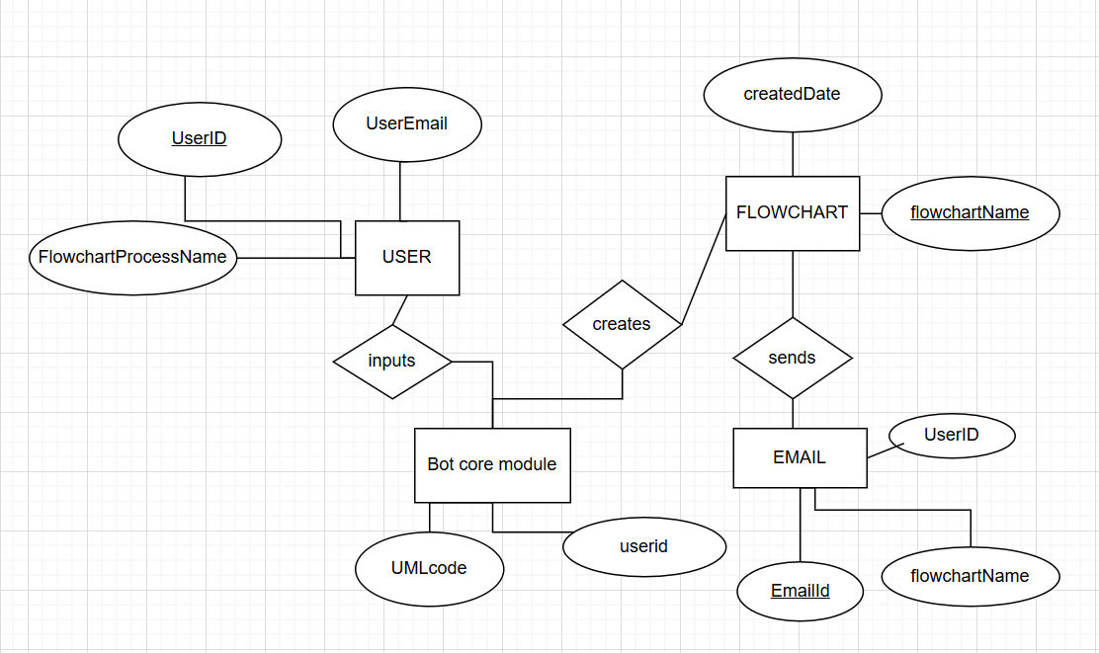
Table Design
ERD:

Slide 12
Process Design
Main Process:
The main process is the overall orchestrator of the workflow and manages high-level actions like user input, validation, flowchart generation, and feedback.
Start (Triggered by user)
Collect User Input (via Input Dialog)
Validate Input (via If conditions)
Generate Flowchart (via Invoke Code to generate PlantUML)
Save Flowchart (via Write Text File or Save As)
Send Email (via Send SMTP Mail if selected)
Provide Feedback (via Message Box)
End

Slide 13
Process Design
Sub Process:
The sub-processes are smaller, reusable tasks that handle specific steps within the main process, such as collecting input, validating data, or generating code.
Collect User Input: Input dialogs or forms to collect details about the flowchart.
Validate Input: Check if input fields are valid and correct.
Generate Flowchart Code: Convert input into flowchart code.
Save Flowchart: Save the generated flowchart to a local file or cloud storage.
Send Flowchart via Email: Send the flowchart to the user via email.
Error Handling: Handle errors and log them appropriately.

Slide 14
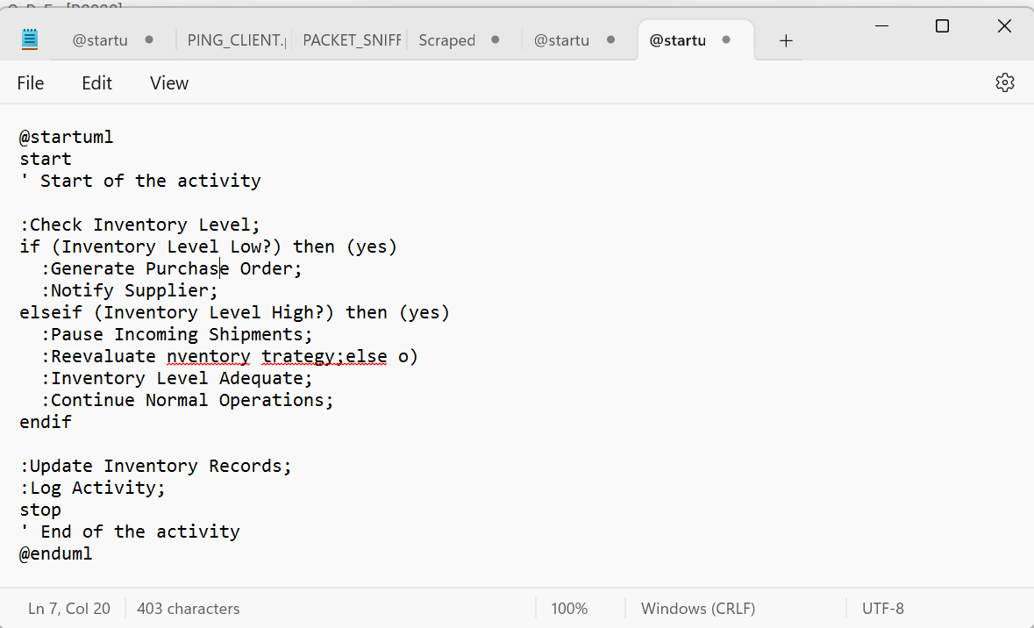
Implementation
Implementation of Flowchart Logic Processor:
  Parsing user-provided flowchart details.Generating PlantUML or other intermediate code
Screen shots of Scraped PlantUML code

Slide 15
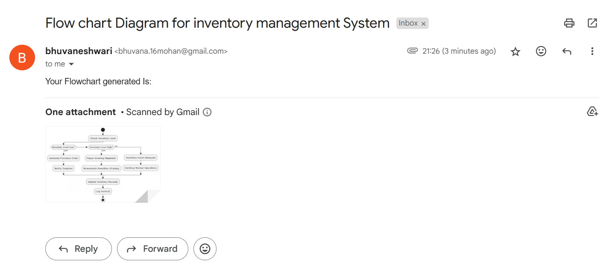
Implementation
Implementation of Output Module:
  It is responsible for producing the final flowchart in the desired format and to send mail to the user
  Screen Shot:

Slide 16
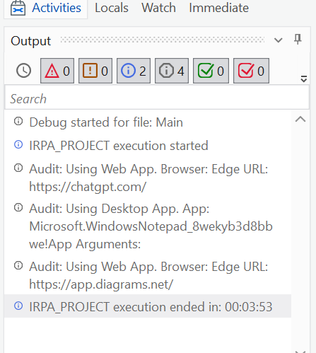
Testing
The UiPath Flowchart Generator has been tested for its functionalities
Screen shots

Slide 17
Conclusions
Description:
  The Flowchart Generator Bot is a specialized tool designed to automate the process of creating flowcharts by generating UML code through AI and using a PlantUML renderer to generate the diagrams. This tool simplifies the visualization of workflows and algorithms by taking user input, automatically converting it into flowchart logic, and rendering it into a clear, visual diagram. With a focus on efficiency and ease of use, the bot eliminates manual diagramming effort, ensuring accurate and consistent results. The integration of AI-driven UML code generation and PlantUML rendering streamlines the diagram creation process, making it accessible to both technical and non-technical users while saving time and reducing the risk of errors.

Slide 18
Future Enhancement
User-Friendly Interface with UiPath Apps
Description: Create a centralized UiPath App interface that serves as the single point of interaction for users to generate flowcharts, ER diagrams, and activity diagrams. The interface should be intuitive and allow users to input data, visualize the process, and receive feedback in real time.
Real-Time Collaboration and Version Control
Description: Enabling multiple users to collaborate on flowchart creation in real-time is a significant enhancement. This would allow teams to work together, providing immediate updates and changes to a diagram as they happen. With version control integrated, users can track all modifications, revert to previous versions, and maintain a clear history of changes.

Slide 19
IEEE Paper
"A Novel Approach for Creating Flowcharts using Generative AI" – This paper discusses the use of generative AI to automate flowchart creation, which is closely related to the process of generating UML or flowchart diagrams automatically based on inputs. It covers techniques and methodologies for improving flowchart generation efficiency.​
Authors:
  Madhura Mhatre; Ananya Pandey; Harsh Rane; Sunita Sahu

Slide 20
References
Journals:
"Code Insight - Flowchart Generator" (IEEE Xplore)
This paper explores how code can be automatically transformed into flowcharts, leveraging machine learning and AI models to generate insights from programming logic and visual representation

Slide 21
Queries

Slide 22


Slide 23
Thank You

